Slide 1
Picking Planar Edges; or,
Drawing a Graph with a
Planar Subgraph
Marcus Schaefer
DePaul University
GD’14 Würzburg
Speaker: Carsten Gutwenger

Slide 2
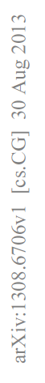
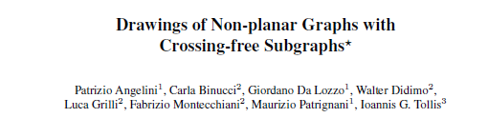
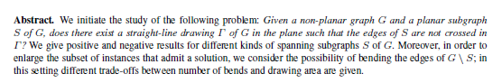
Notes:
The first paper to investigate a new notion of planarity
- Only part of the graph has to be planar, so we call it partial planarity

Slide 3

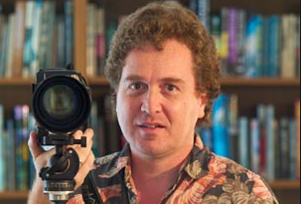
Partial Planarity
“If you're given a graph in which some edges are allowed to participate in crossings while others must remain uncrossed, how can you draw it, respecting these constraints?”
Notes:
Eppstein very clearly summarized the problem in his blog when discussing the Italian paper.

Slide 4
Partial Planarity: Examples
crossing-free
crossings allowed
Notes:
Two examples. The red edges have to be free of crossings.
Which of the two K_{3,3}s can be drawn (audience question).
Although the left graph allows more crossing edges, it’s the right one that can be drawn

Slide 5
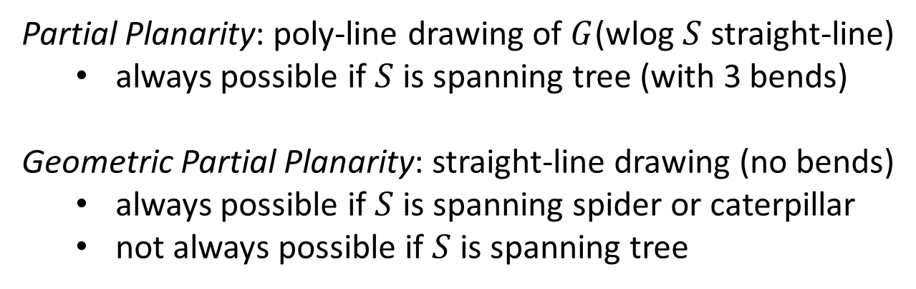


Results by Angelini et al, 13
crossing free subgraph $S$
additional edges $G\backslash S$
Partial Planarity: poly-line drawing of $G$(wlog $S$ straight-line)
  always possible if $S$ is spanning tree (with 3 bends)
Geometric Partial Planarity: straight-line drawing (no bends)
  always possible if $S$ is spanning spider or caterpillar
  not always possible if $S$ is spanning tree
Notes:
Angelini et al considered two main variants, depending on whether the drawing is straight-line (geometric partial planarity), or poly-line (partial planarity).
They are mostly interested in distinguishing cases which can and cannot be realized. To that end, they also (in the partial planarity variant) restrict the planar subgraph to be straight-line. This doesn’t affect realizability, but it may increase the number of bends along the crossing edges.
Their main result for partial planarity is that it is always possible if S is a spanning tree, and at most 3 bends for crossing edges are sufficient
For geometric partial planarity, it is always possible if S is a spanning spider or caterpillar, and there are spanning trees for which some graph is not realizable

Slide 6
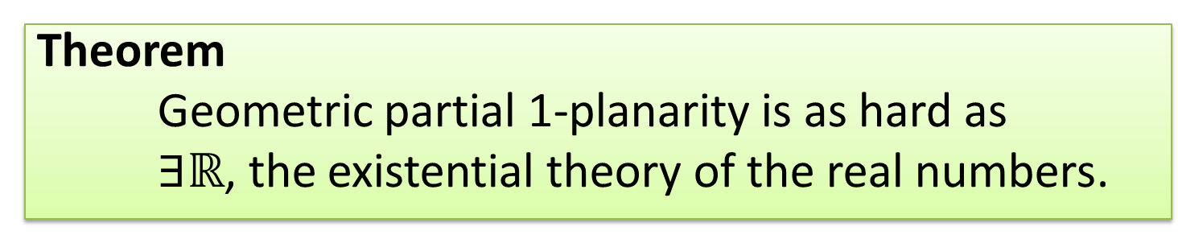

Our Results
Theorem
Partial planarity is solvable in polynomial time.
edge is 1-planar if it has at most one crossing
Theorem
Geometric partial 1-planarity is as hard as
$∃ℝ$, the existential theory of the real numbers.
$$NP⊆∃ℝ⊆PSPACE$$
Notes:
We are interested in the complexity of partial planarity and partial geometric planarity.
We can only settle partial planarity, it’s polynomial-time solvable.
For geometric partial planarity, we cannot determine the complexity
However, if instead of specifying that some edges are planar, we instead specify that they are 1-planar (i.e. allow one crossing), then the problem is as hard as deciding truth in the existential theory of the real numbers
The complexity of the existential theory of the reals lies between NP and PSPACE, more later.

Slide 7
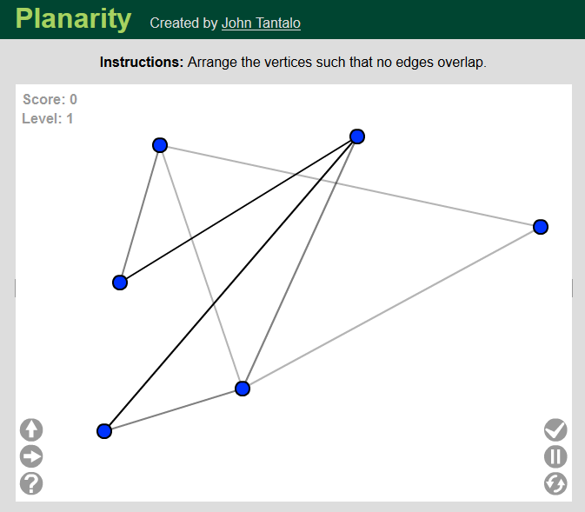
Planar?
Notes:
Our favorite game. Is this graph planar? Well, yes, since it’s part of the planarity game, but how can we see this?

Slide 8
Yes!
Theorem (Hanani-Tutte)
  If graph has drawing in which every two independent edges cross
  an even number of times, then graph is planar.
Notes:
Using Hanani-Tutte: we redraw three of the edges slightly, moving small parts of them across some of the vertices in the drawing.
As a result the parity of crossing between the edge and every edge incident to the vertex changes.
As we can see (by checking one or two examples),in this case, this leads to every pair of independent edges crossing evenly.
So by Hanani-Tutte, the graph is planar.
State Hanani-Tutte Theorem

Slide 9

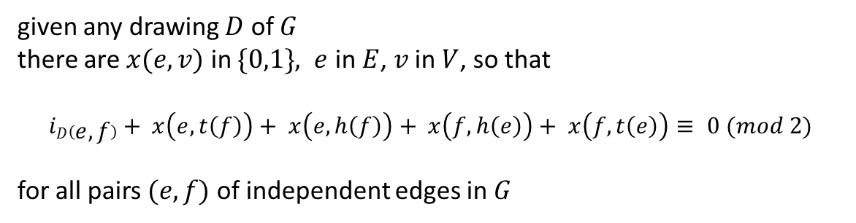

Algebraic Hanani-Tutte (Wu, Tutte)
t(e)
$G$ planar ↔ there is a plane drawing $D$ of $G$
e
↔
h(e)
given any drawing $D$ of $G$
there are $x(e,v)$ in $\{0,1\}, e$ in $E$, $v$ in $V$, so that
$iD\left(e,f\right)+ x\left(e,t\left(f\right)\right)+ x\left(e,h\left(f\right)\right)+ x\left(f,h\left(e\right)\right)+ x\left(f,t\left(e\right)\right)≡ 0 (mod 2)$
for all pairs $(e,f)$of independent edges in $G$
Polynomial time planarity algorithm, $O(n6)$
Notes:
The deformation of an edge e across v, is called an e,v move.
We can describe the result of making an (e,v)-move on a given drawing algebraically:
i_D(e,f) is the number of times e and f cross in some initial drawing D. We want this to be 0 (modulo 2).
The parity of e and f crossing is affected by moving one of them across the endpoint of the other, that’s four possibilities, each a 0/1 choice.
We set up variables for these, x(e,v) = 1 for making the (e,v)-move, and x(e,v)=0 for not.
Then the set of equations stated here models planarity by the Hanani-Tutte theorem, so HT is algebraic, as observed by both Wu (in the 60s) and Tutte (early 70s)
This gives a polynomial time planarity algorithm, time O(n^6). In special cases, this can be improved (level-planarity, quadratic).
It can even be made pratcial for C-planarity (Gutwenger, Mutzel, Schaefer, 2014)

Slide 10
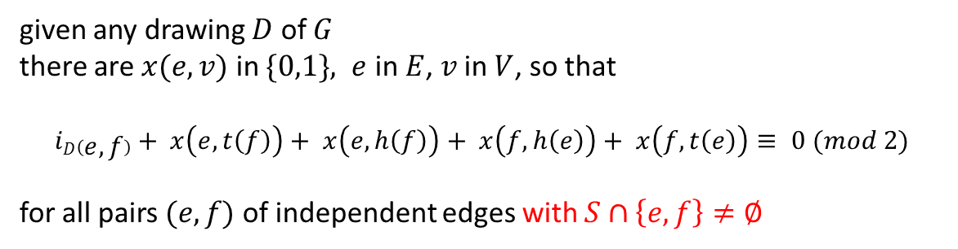

Partial Planarity, Algebraically
t(e)
$(G,S)$ is partial planar
e
↔
h(e)
given any drawing $D$ of $G$
there are $x(e,v)$ in $\{0,1\}, e$ in $E$, $v$ in $V$, so that
$iD\left(e,f\right)+ x\left(e,t\left(f\right)\right)+ x\left(e,h\left(f\right)\right)+ x\left(f,h\left(e\right)\right)+ x\left(f,t\left(e\right)\right)≡ 0 (mod 2)$
for all pairs $(e,f)$of independent edges with $S∩\left\{e, f\right\}≠∅$
Polynomial time planarity algorithm, $O(n6)$
Notes:
Note the small change. If we want only the set of edges S as part of G to be planar, we only need to modify the set of equations:
We only require it for pairs of independent edges at least one of which belongs to S.
Intuitively, we are saying, the edges in S satisfy the HT condition, they are independently even.
This again yields a polynomial time criterion (not implemented at this point).
But is it correct?

Slide 11
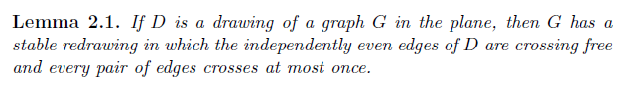
Missing Ingredient
crossing free subgraph $S$
additional edges $G\backslash S$
From Removing Independently Even Crossings (Pelsmajer, Schaefer, Štefankovič, 09)
Notes:
Yes, it is, by a lemma which allows us to remove independently even crossings from a (PSS, 2009) paper.
In our initial example here are the moves that make the red graph crossing free.
There is one odd crossing between red edges; that’s removed by making two (e,v)-moves, so e only crosses independent and one green edge
At this point one of the green edges still crosses one of the red edges oddly, which is easily removed, by pushing the green edge across the endpoint of the red edge it crosses oddly
So we have a correct polynomial-time algorithm for recognizing partial planarity.
Once a solution to the algebraic system is known, O(n^6), an actual layout can be found in quadratic time.
So what about geometric partial planarity?

Slide 12
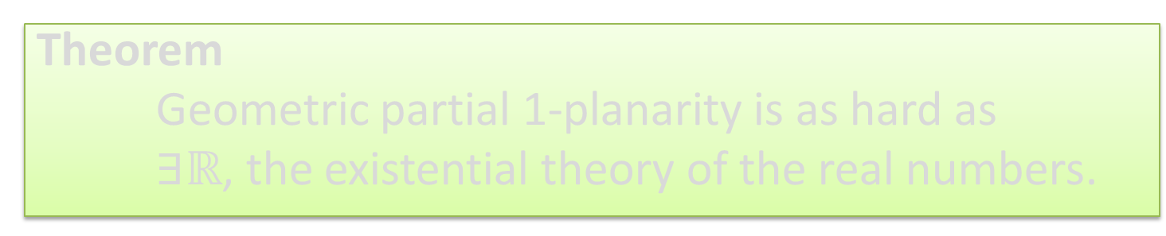

Our Results
Theorem
Partial planarity is solvable in polynomial time.
edge is 1-planar if it has at most one crossing
Theorem
Geometric partial 1-planarity is as hard as
$∃ℝ$, the existential theory of the real numbers.
$$NP⊆∃ℝ⊆PSPACE$$
Notes:
So we proved:

Slide 13
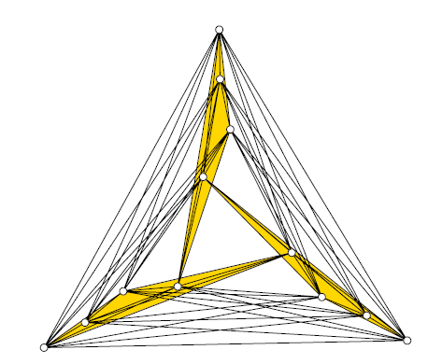
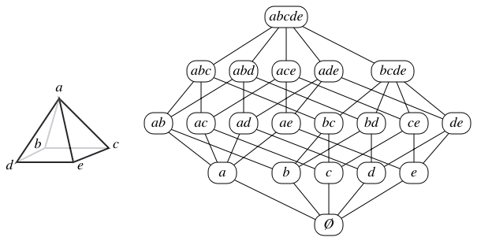

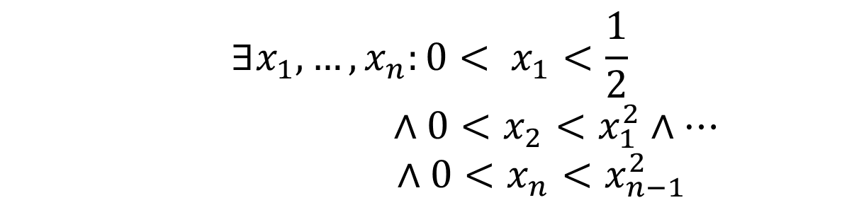
Existential Theory of the Real Numbers
E.g.
$$∃x, y, z:x^{2}=x∧y^{2}=y∧x<y∧z^{2}=y+y$$
$$∃x_{1},…, x_{n}:{0< x}_{1}<\frac{1}{2}$$
$$∧0<x_{2}<x_{1}^{2}∧…$$
$∧0<x_{n}<x_{n−1}^{2}$
Notes:
What is the existential theory of the reals? Let’s look at two sample formulas.
What does the first one express? x =0,1; y = 0,1, x<y, so y = 1, and z^2 = y. It expresses the existence of the square root of 2.
What does the second one express? Each x_i is less than the square of the previous one, which is less than 1. The final x_n will require exponential precision (an exponential number of bits) to write down.
Deciding the truth of statements of this type: existential quantifiers, Boolean formulas over real variables, with + and * is ETR, the existential theory of the reals
This captures the complexity of several well-known problems in graph drawing. From left to right:
Stretchability of pseudoline arrangements: can a given specification of how a set of lines crosses be realized by straight lines in the plane? The picture in the arrangement is not realizable (it’s the Pappus configuration)
2nd: The rectilinear crossing number (here a picture from the crossing number project, crossing number of K_12).
3rd: The algorithmic Steinitz problem: given a lattice, is it the facial lattice of a polytope?
4th: given a set of line segments and a specification of which pairs of line segments cross and which don’t, can this specification be realized?
All of these (and many others: unit disk graphs, unit distance graphs, …) have the same computational complexity, so it makes sense to give it a name: ER (exists-R)

Slide 14
Stretchability of
Pseudoline Arrangements
Not stretchable (Pappus’ Configuration)
Pseudoline arrangement
Equivalent line arrangement
Notes:
Here is a particular example. We are given a pseudoline arrangement (a group of curves so that any two cross exactly once), and a specificaiton in which order they cross. Can this arrangement be realized by straight lines in the plane. Top example is negative (Pappus configuration, the red line has to pass through the crossing of the other two diagonal edges, it cannot lie above it).
Below a positive example; this arrangement can be stretched, as shown by the equivalent (straight) line arrangement on the right
Deciding the stretchability of pseudoline arrangements is ER-complete. This was shown (in different language) by Mnew in the 80s (his famous universality theorem). A version more accessible to computer scientists was given by Peter Shor.
- Either proof allows us to treat stretchability of pseudolines as an ER-complete problem, just like SATISFIABILITY for NP.

Slide 15
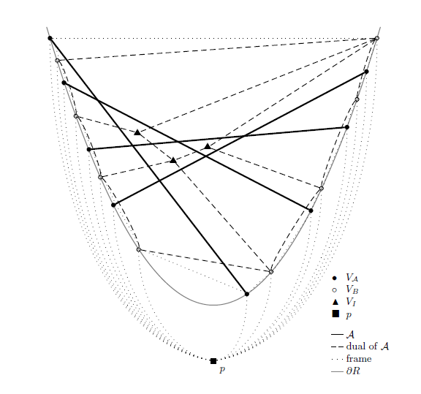
Notes:
And here is the reduction from STRETCHABILITY to partial geometric 1-planarity.
The four heavy black lines encode the 4 lines of the pseudoline arrangement we saw before (which is realizable, which is why we can draw them as straight-lines here)
The dashed lines with the triangular vertices are the dual of the arrangement, and force the arrangement to be as specified; all these edges are 1-planar, so they can cross at most one other edge. That forces the dual arrangement.
The rest is framework (the parabola, and the outer edges). The framework can be forced to be crossing free by using a gadget (a K_6 essentially).

Slide 16
Our Results
Theorem
Partial planarity is solvable in polynomial time.
edge is 1-planar if it has at most one crossing
Theorem
Geometric partial 1-planarity is as hard as
$∃ℝ$, the existential theory of the real numbers.
$$NP⊆∃ℝ⊆PSPACE$$
Notes:
So we proved

Slide 17
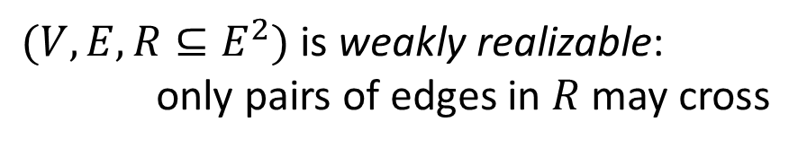
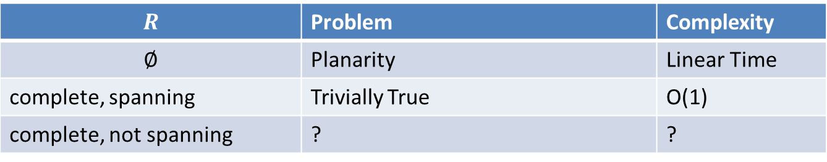
Weak Realizability
$(V,E,R⊆E^{2})$ is weakly realizable:
only pairs of edges in $R$ may cross
$$R$$ | Problem | Complexity
$$∅$$ | Planarity | Linear Time
complete, spanning | Trivially True | O(1)
complete, not spanning | ? | ?
Notes:
Let us sketch one more connection. Weak realizability is a very powerful graph drawing problem, it models nearly all known graph drawing variants (not including straight-line variants). A graph (V,E) with a relation R on the edges is weakly realizabile if there is a drawing in which only pairs of edges in R are allowed to cross (but don’t have to cross). Some special cases:
If R is the empty set, then we have planarity, solvable in linear time
If R is a complete graph on E, which is spanning, then the problem is always is solvable, trivially.
What if R is complete graph on E, but not spanning?

Slide 18
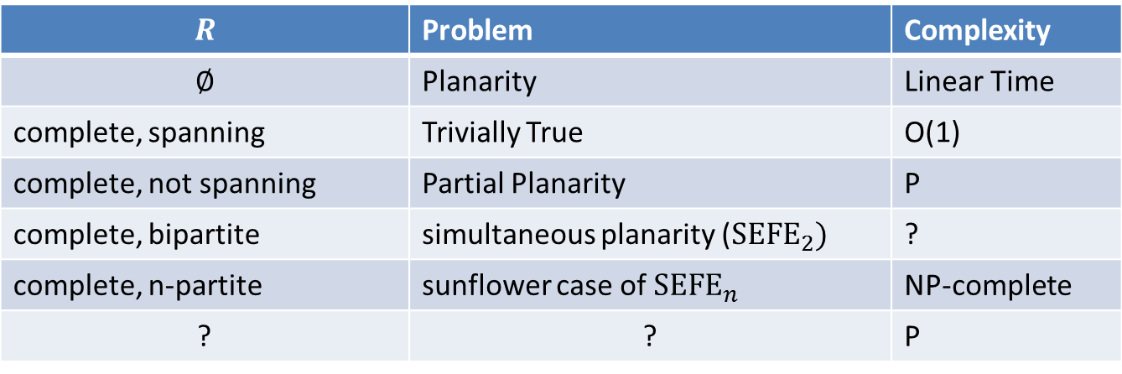
Weak Realizability
$(V,E,R⊆E^{2})$ is weakly realizable:
only pairs of edges in $R$ may cross
$$R$$ | Problem | Complexity
$$∅$$ | Planarity | Linear Time
complete, spanning | Trivially True | O(1)
complete, not spanning | Partial Planarity | P
complete, bipartite | simultaneous planarity (${SEFE}_{2})$ | ?
complete, n-partite | sunflower case of ${SEFE}_{n}$ | NP-complete
? | ? | P
Notes:
In that case we get exactly partial planarity. The complete graph picks out the edges that are allowed to cross each other. The rest is planar. So we know the problem is in P.
If R is complete and bipartite, we get exactly the SEFE2 problem, complexity unknown.
If R is complete and n-partite, we get the sunflower case of SEFEn (that is the common graph of any two graphs is the same); this problem is NP-complete.
- Are there other special cases of R that can be settled? Paths, Trees?

Slide 19
Excluded Minors: All?
crossing-free
Operations
  Delete vertex, edge
  Contract / edge
  Turn / into / edge
crossings allowed
Notes:
One final question: is there an excluded minor characterization? The following three graphs are not partially planar (all using HT argument: all crossings are between pairwise dependent edges). The minor operations we allow are the usual + allowing turning a red edge (crossing-free) into a green edge (crossing allowed).

Slide 20
Excluded Minors: All?
Bojan Mohar
crossing-free
Operations
  Delete vertex, edge
  Contract / edge
  Turn / into / ege
crossings allowed
Notes:
Actually, Bojan Mohar already solved the problem. Yes, these are all the possible minors.

Slide 21
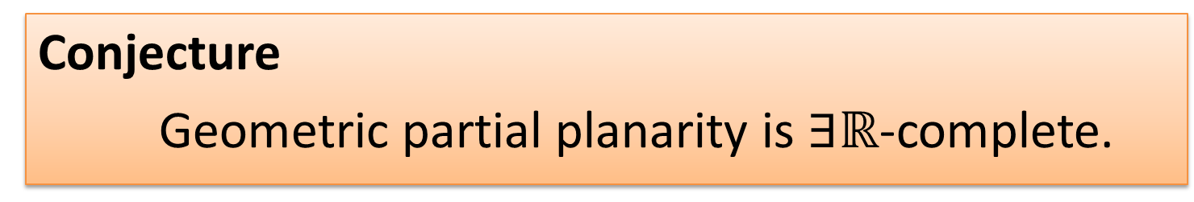
Conjecture
Geometric partial planarity is $∃ℝ$-complete.
but
Theorem
Geometric 1-planarity is NP-complete.
Notes:
The result on partial geometric 1-planarity is only a stepping stone, we think that geometric partial planarity is as hard, but the encoding will be much harder, since encoding the arrangement requires edges with a limited number of crossings. Allowing no crossing seems tough.
Compare,however, the fact that if we drop the partial, the problem becomes NP-complete (interesting part is that it lies in NP: once the rotation is known, geometric 1-planarity can be checked in linear time (Seok-Hee Hong, Peter Eades, Giuseppe Liotta, and Sheun
g-Hung Poo, 2012), so it’s sufficient to guess the rotation in NP.

Slide 22
Thank You

