Slide 1
A crossing lemma for the pair-crossing number
Eyal Ackerman and Marcus Schaefer

Slide 2
A crossing lemma for the pair-crossing number
weaker than advertised
Eyal Ackerman and Marcus Schaefer

Slide 3
A crossing lemma for the pair-crossing number
a variant of
Eyal Ackerman and Marcus Schaefer

Slide 4
The crossing lemma
The crossing number of a graph $G$, $\text{cr}(G)$, is the minimum number of edge crossings in a drawing of $G$ in the plane.
Crossing Lemma: For every graph $G$ with $n$ vertices and $e≥4n$ edges $\text{cr}(G)≥c∙e^{3}/n^{2}$.
[Ajtai, Chvátal, Newborn, Szemerédi 1982; Leighton 1983]
Tight, up to $c$.
$$\frac{1}{64} ≤ \frac{1}{33.75} ≤ \frac{1}{31.1} ≤ \frac{1}{29}≈0.0345 ≤ c ≤ 0.09$$
folklore
Pach & Tóth 97
Pach et al. 06
A. 2013
Pach & Tóth 97

Slide 5
The crossing lemma
Proof:
$cr\left(G\right)≥e−3n$
Consider a drawing with $cr(G)$ crossings
Pick every vertex with probability $p$ and get $G′$
$\text{Ex}\left(n^{′}\right)=pn, \text{Ex}\left(e^{′}\right)=p^{2}e, \text{Ex}\left(\text{cr}(G^{′})\right)≤p^{4}\text{cr}\left(G\right)$
$Ex(\text{cr}\left(G^{′}\right))≥\text{Ex}(e^{′})−3∙\text{Ex}(n^{′})$
Plug in the expected values and set $p=4n/e≤1$ $∎$
The crossing number of a graph $G$, $\text{cr}(G)$, is the minimum number of edge crossings in a drawing of $G$ in the plane.
Crossing Lemma: For every graph $G$ with $n$ vertices and $e≥4n$ edges $\text{cr}(G)≥c∙e^{3}/n^{2}$.
[Ajtai, Chvátal, Newborn, Szemerédi 1982; Leighton 1983]
Tight, up to $c$.
$$\frac{1}{64} ≤ \frac{1}{33.75} ≤ \frac{1}{31.1} ≤ \frac{1}{29}≈0.0345 ≤ c ≤ 0.09$$
folklore
Pach & Tóth 97
Pach et al. 06
A. 2013
Pach & Tóth 97

Slide 6
Other crossing numbers
$\overline{cr}(G)$ – min number of crossings when $G$ is drawn with straight-line edges.
$pcr(G)$ – min number of pairs of edges that cross.
$ocr(G)$ – min number of pairs of edges that cross oddly.
And many more… [Schaefer 2013]

Slide 7
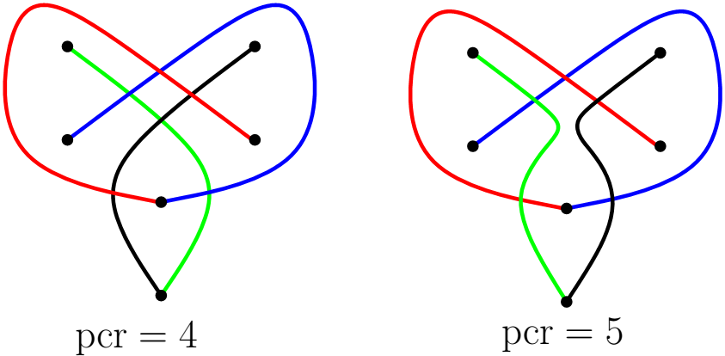
Adjacent crossings
Are adjacent crossings redundant?
Tutte: “… crossings of adjacent edges are trivial, and easily got rid of”.
True for $cr$ but not necessarily for other variants.
Pach and Tóth:
Rule +: Adjacent crossings are not allowed.
Rule -: Adjacent crossings are not counted.
Rule 0: Adjacent crossings are allowed and counted.
Fulek et al. , Adjacent crossings do matter, GD 2011: there are graphs $G$ such that $ocr$₋$(G)$ $< ocr(G)$.

Slide 8
Other crossing lemmas
$$\frac{e^{3}}{64n^{2}}≤$$
$ocr$₋$\left(G\right)≤ ocr\left(G\right)≤pcr\left(G\right)≤pcr$₊$(G)≤cr(G)$ $≤\overline{cr} (G)$
Using the probabilistic proof and the strong Hanani-Tutte Theorem
Thm: $p\text{cr}(G)≥\frac{1}{34.2}∙e^{3}/n^{2}$.*
Thm: $p\text{cr}$₊$(G)≥\frac{1}{34.2}∙e^{3}/n^{2}$.*
* If $G$ is not too sparse.

Slide 9
Improving via local crossing number
The local crossing number of a graph $G$, $l\text{cr}(G)$, is the minimum $k$ such that $G$ can be drawn with at most $k$ crossings per edge.
Or: $l\text{cr}\left(G\right)$ = minimum $k$ such that $G$ is $k$-planar.
Improving the crossing lemma:
Prove that if $l\text{cr}\left(G\right)$ is “small” then $G$ is “sparse”.
E.g., if $l\text{cr}\left(G\right)≤1$ then $e≤4(n−2)$.
Use it to get a “weak” bound $\text{cr}\left(G\right)≥α∙e−β∙n$.
E.g., $\text{cr}\left(G\right)≥2\left(e−4n\right)≥2e−8n$
Use the weak bound instead of $\text{cr}\left(G\right)≥e−3n$ in the probabilistic proof of the crossing lemma.

Slide 10
Improving via local crossing number (2)
$l\text{cr}\left(G\right)=0$ $⟹$ $e≤3\left(n−2\right)$ [Euler]
$l\text{cr}\left(G\right)≤1$ $⟹$ $e≤4(n−2)$
$l\text{cr}\left(G\right)≤2$ $⟹$ $e≤5(n−2)$
$l\text{cr}\left(G\right)≤3$ $⟹$ $e≤5.5(n−2)$
$l\text{cr}\text{∗}\left(G\right)≤4$ $⟹$ $e≤6(n−2)$
$l\text{cr}\left(G\right)≤k$ $⟹$ $e≤3.81\sqrt{k}n$
[Pach & Tóth 1997]
[Pach et al. 2006]
[A. 2013]

Slide 11
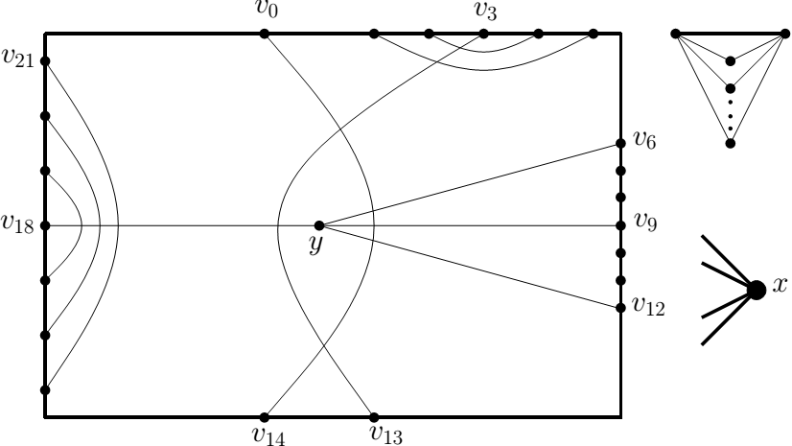
The local pair-crossing number
The local pair-crossing number of a graph $G$, $lp\text{cr}(G)$, is the minimum $k$ such that $G$ can be drawn with every edge crossing at most $k$ other edges (each of them possibly more than once).
Clearly, $l\text{pcr}\left(G\right)≤lcr(G)$.
It can happen that $l\text{pcr}\left(G\right)<lcr(G)$:
$$l\text{pcr}\left(G\right)=4$$
$$l\text{cr}\left(G\right)=5$$

Slide 12
$l\text{pcr}\left(G\right)$ vs. $l\text{cr}\left(G\right)$
$l\text{cr}\left(G\right)<2^{lpcr(G)}$ [Schaefer & Štefankovič 2004]
Thm: If $l\text{pcr}\left(G\right)≤2$ then $l\text{pcr}\left(G\right)=lcr(G)$.
Cor: $l\text{p}\text{cr}\left(G\right)=0$ $⟹$ $e≤3\left(n−2\right)$
$l\text{p}\text{cr}\left(G\right)≤1$ $⟹$ $e≤4\left(n−2\right)$
$l\text{p}\text{cr}\left(G\right)≤2$ $⟹$ $e≤5\left(n−2\right)$
Just saw: $l\text{pcr}\left(G\right)=4⇏l\text{cr}\left(G\right)=4$.
Open: $l\text{pcr}\left(G\right)=3 ⇒l\text{cr}\left(G\right)=3$ ?
If true, then $l\text{pcr}\left(G\right)≤3$implies $e≤5.5(n−2)$.
Thm: if $l\text{pcr}\left(G\right)≤3$then $e≤6(n−2)$.

Slide 13
Improving the crossing lemma for pcr₊
Using the bounds on the size of graphs with small $l\text{pcr}$ we get: $\text{pcr}$₊$\text{(}\text{G}\text{)}≥pcr\left(G\right)≥4e−18n$
Plugging this bound into the probabilistic proof yields $p\text{cr}$₊$(G)≥\frac{1}{34.2}∙e^{3}/n^{2}$ for $e≥6.75n$.

Slide 14
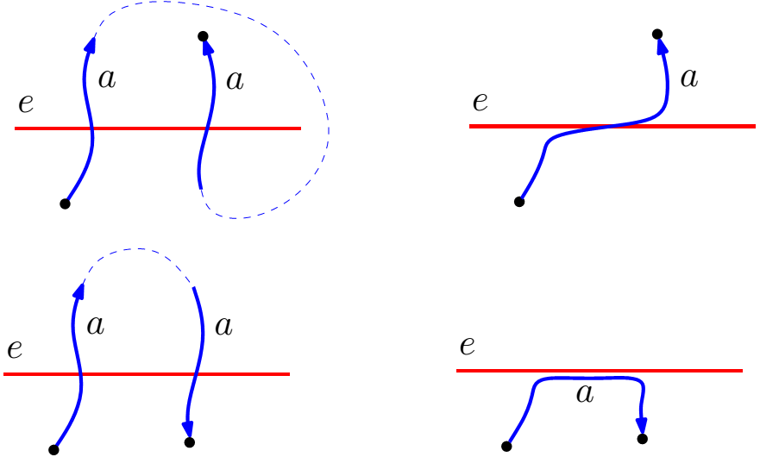
Proving $l\text{pcr}\left(G\right)≤2⟹l\text{cr}\left(G\right)≤2$
$l\text{cr}\left(G\right)≤3$since $l\text{cr}\left(G\right)<2^{lpcr(G)}$
$D$ – a drawing of $G$ with the least number of crossings such that $l\text{cr}\left(D\right)≤3$.
Suppose that $e$ is crossed 3 times:
No consecutive crossings with the same edge:

Slide 15
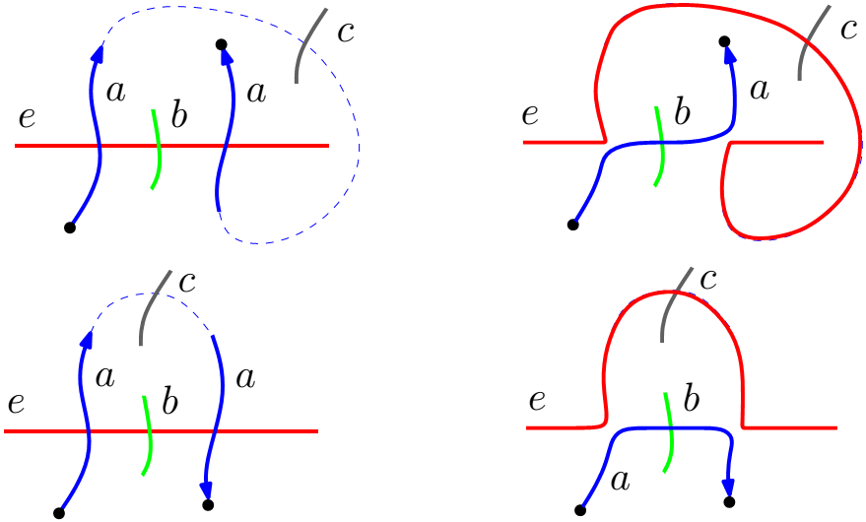
Proving $l\text{pcr}\left(G\right)≤2⟹l\text{cr}\left(G\right)≤2$
$l\text{cr}\left(G\right)≤3$since $l\text{cr}\left(G\right)<2^{lpcr(G)}$
$D$ – a drawing of $G$ with the least number of crossings such that $l\text{cr}\left(D\right)≤3$.
Suppose that $e$ is crossed 3 times:
Crossing pattern must be $aba$:

Slide 16
Summary and open problems
A pair-crossing lemma: For every graph $G$ with $n$ vertices and $e≥6.75n$ edges $p\text{cr}$₊ $(G)≥\frac{1}{34.2}∙e^{3}/n^{2}$
Does it hold for $\text{pcr}$?
Is it true that $\text{pcr}\left(G\right)=pcr$₊$(G)$?
Is it true that $\text{pcr}\left(G\right)=cr(G)$?
Known: $\text{cr}\left(G\right)=\tilde{O}({(\text{pcr}\left(G\right))}^{3/2})$ [Matousek 2013]

Slide 17
Summary and open problems (2)
$l\text{cr}\left(G\right)<2^{lpcr(G)}$
Is it true that $l\text{cr}\left(G\right)<poly(lpcr\left(G\right))$ ?
Thm: If $l\text{pcr}\left(G\right)≤2$ then $l\text{pcr}\left(G\right)=lcr(G)$.
There is $G$ such that $l\text{pcr}\left(G\right)=4<l\text{cr}\left(G\right)=5$.
Open: $l\text{pcr}\left(G\right)=3 ⟹l\text{cr}\left(G\right)=3$ ?
Thm: if $l\text{pcr}\left(G\right)≤3$then $e≤6(n−2)$.
What about the local odd-crossing number?
$l\text{o}\text{cr}\left(G\right)=1 ⟹l\text{cr}\left(G\right)=1$ ?

Slide 18
Thank you and

Slide 19
