Slide 1
Drawing Planar Graphs with Reduced Height
Stephane Durocher Debajyoti Mondal
Department of Computer Science
University of Manitoba
GD 2014
September 26, 2014
Notes:
Thank you session chair, I am going to present our paper entitled Drawing Plane Triangulations with Few Segments.
This is a joint work with my supervisor dr. stephane durocher.
And we are from University of Manitoba.

Slide 2
Straight-line Drawings (Fixed Vs. Variable)
a
a
b
d
c
f
e
b
g
c
a
b
c
A straight-line drawing of G on a 5×5 grid
A straight-line drawing of G with height 4
A planar graph G
GD 2014
September 26, 2014

Slide 3
Straight-line Drawings (Fixed Vs. Variable)
a
a
b
d
c
f
e
b
g
c
a
b
c
A straight-line drawing of G on a 5×5 grid
A straight-line drawing of G with height 4
A planar graph G
f
f
e
g
g
e
GD 2014
September 26, 2014

Slide 4
Straight-line Drawings (Fixed Vs. Variable)
a
b
f
d
f
e
b
g
c
a
g
e
A planar graph G
c
Here we allow variable embedding.
Sometimes we use edge-bends.
Focus on height.
Via visibility representation
Biedl, 2014

Slide 5
Fixed Embedding
Upper Bounds
Lower Bounds
Triangulations
Area Height
2n² + O(1) n − 2 [de Fraysseix et al. 1990]
n² + O(1) n − 2 [Schnyder 1990]
1.78n² + O(1) 0.66n [Chrobak and Nakano 1998]
0.88n² + O(1) 0.66n [Brandenburg 2008]
0.44n² + O(1) 0.66n (polyline) [Bonichon et al. 2003]
Nested Triangles Graph
Area Height
0.44n² +O(1) 0.66n [Dolev et al. 1984]
A class of planar 3-trees
Area Height
0.44n² + O(1) 0.66n [Frati and
Patrignani 2008, Mondal et al. 2010]
Variable Embedding
Upper Bounds
Improved Upper Bounds
Triangulations
Area Height
0.88n² + O(1) 0.66n [Brandenburg 2008]
0.44n² + O(1) 0.66n (polyline) [Bonichon et al. 2003]
Planar 3-trees
Area Height
0.88n² + O(1) 0.5n [Brandenburg 2008, Hossain et al. 2013]
Nested Triangles Graph
Area Height
0.22n² + O(1) 0.33n [Frati and Patrignani 2008]
Triangulations
Polyline drawing with height
4n/9+O(λ∆) ≈ 0.44n+O(λ∆)
This is 0.44n+o(n) when ∆ is o(n)
Planar 3-trees
Straight-line drawing with height
4n/9+O(1) ≈ 0.44n+O(1)

Slide 6
Idea: Use the Simple Cycle Separator
[Djidjev and Venkatesan, 1997]
Every planar triangulation has a simple cycle separator of size O(√n)
An n-vertex planar graph G
A simple cycle separator of G
A separator of size O(√n)
G_{o} with 2n/3+O(√n) vertices
G_{i} with 2n/3+O(√n) vertices

Slide 7
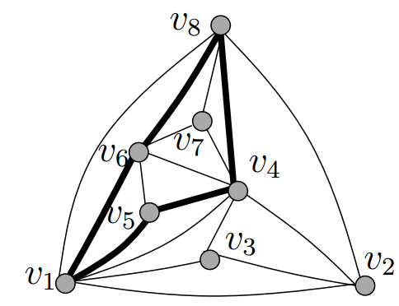
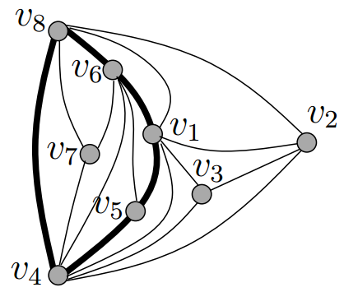
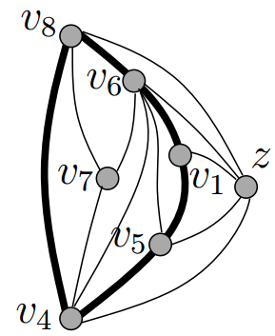
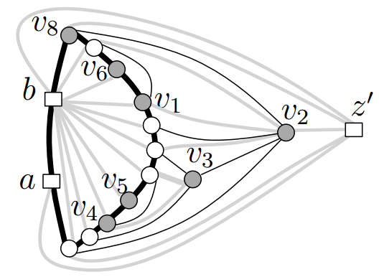
The Big Picture
v₈
v₆
w
b
v₈
v₇
v₁
v₅
v₅
v₆
v₄
v₃
v₁
v₄
v₂
Towards w’
Drawing and Merge
Choose an Embedding
a
w
w'
Decomposition
G_{i}
G_{o}

Slide 8
Technical Details (Choose an Embedding)
Choose a face which is incident to some edge of the cycle separator as the new outer face.
GD 2014
September 26, 2014

Slide 9
Technical Details (Construct G_{o} and G_{i})
Choose a face which is incident to some edge of the cycle separator as the new outer face.
Construct G_{o} and G_{i}
G_{i}
G_{o}
GD 2014
September 26, 2014

Slide 10
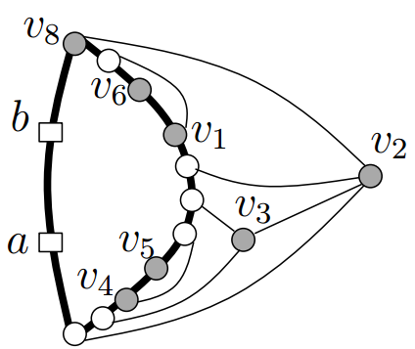
Technical Details (Draw G_{o} and G_{i})
G_{i}
G_{o}
w
GD 2014
September 26, 2014

Slide 11
Technical Details (Draw G_{o} and G_{i})
G_{i}
G_{o}
v₈
w
v₆
w
v₇
v₁
v₅
v₄
GD 2014
September 26, 2014

Slide 12
Technical Details (Draw G_{o} and G_{i})
G_{i}
G_{o}
v₈
w
v₆
w'
w
v₇
v₁
v₅
v₄
GD 2014
September 26, 2014

Slide 13
Technical Details (Draw G_{o} and G_{i})
w’
w
G_{i}
G_{o}
v₈
w
b
v₆
v₈
v₇
v₁
D_{o}
v₅
v₅
v₆
v₄
v₁
D_{i}
v₃
v₄
v₂
Towards w’
a

Slide 14
Technical Details (Merge D_{o} and D_{i})
v₈
v₆
v₇
v₁
v₅
D_{o}
v₄
D_{i}
v₃
v₂

Slide 15
Technical Details (Merge D_{o} and D_{i})
Height of D_{i} is (2/3)×|D_{i}| = 4n/9+O(λ)
Height of D_{o} is (2/3)×|D_{o}| = 4n/9+O(λ∆)
Height of the final drawing is 4n/9+O(λ∆)
At most 6 bends per edge
- two bends to enter D_{o} from D_{i}
- two bends on separator
- two bends to return to D_{i} from D_{o}
v₈
v₆
v₇
v₁
v₅
D_{o}
v₄
D_{i}
v₃
Improve to 4 bends per edge using the transformation via visibility representation [Biedl 2014]
v₂

Slide 16
Plane 3-Trees
a
a
f
b
c
a
b
c
d
a
f
e
a
d
d
f
b
g
c
f
e
b
c
A planar 3-tree
b
c
Start with a triangle, then repeatedly add a vertex and triangulate the resulting graph.
GD 2014
September 26, 2014

Slide 17
Plane 3-Trees
a
a
f
b
c
a
b
c
d
a
f
e
a
d
d
f
b
g
c
f
e
b
c
A planar 3-tree
b
c
f
f
f
f
d
d
g
d
e
e
The representative tree

Slide 18
Plane 3-Trees
a
r
b
c
A planar 3-tree G
The representative tree T of G
GD 2014
September 26, 2014

Slide 19
Plane 3-Trees
a
Each component with at most n/2 vertices
r
r
v
v
b
c
A planar 3-tree G
The representative tree T of G
a
Choosing a suitable embedding
F
G₃
G₁
v
w
v
w
F
G₂
b
c
A planar 3-tree G

Slide 20
Plane 3-Trees
a
Choosing a suitable embedding
F
G₃
G₁
v
w
v
w
F
G₂
b
c
A planar 3-tree G
a
r
G₁
G₂
G₃
b
G₄
c

Slide 21
Plane 3-Trees
a
x
F
G₃
G₁
v
w
w₂
v
w
w₁
w₃
w_{t}
F
G₂
b
c
y
A planar 3-tree G
Plane 3 trees inside each of these triangles has n/2+O(1) vertices
x
4n/9 + O(1)
v
w₁
w
w₂
y
GD 2014
September 26, 2014

Slide 22
Plane 3-Trees
a
x
Choosing a suitable embedding
F
G₃
G₁
v
w
w₂
v
w
w₁
w₃
w_{t}
F
G₂
b
c
y
A planar 3-tree G
The main challenge here is to show that the number of lines that are intersecting each triangle is sufficient to draw the corresponding plane 3-tree
x
4n/9 + O(1)
v
v
w₁
w
w₂
w
y
GD 2014
September 26, 2014

Slide 23
v₈
Thank you
v₆
v₇
v₁
v₅
v₄
v₃
v₂
a
r
OPEN: Close the gap!
r
v
v
b
c
Upper Bounds
Improved Upper Bounds
Triangulations
Area Height
0.88n² + O(1) 0.66n [Brandenburg 2008]
0.44n² + O(1) 0.66n (polyline) [Bonichon et al. 2003]
Planar 3-trees
Area Height
0.88n² + O(1) 0.5n [Brandenburg 2008, Hossain et al. 2013]
Triangulations
Polyline drawing with height
4n/9+O(λ∆) ≈ 0.44n+O(λ∆)
This is 0.44n+o(n) when ∆ is o(n)
Planar 3-trees
Straight-line drawing with height
4n/9+O(1) ≈ 0.44n+O(1)

Slide 24
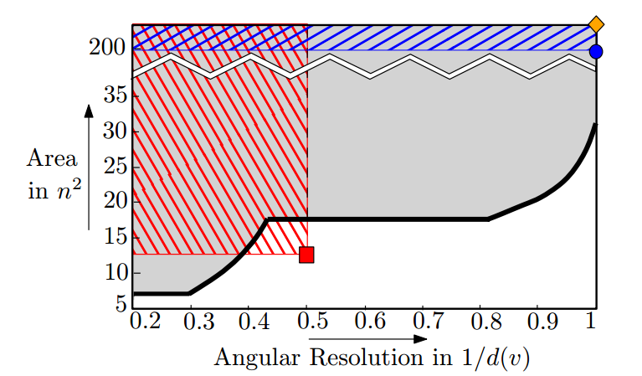
Thank You..
v₈
v₁
v₈
v₁
v₈
v₇
v₆
v₆
v₇
v₄
v₅
v₆
v₇
v₄
v₃
v₁
v₂
v₄
v₃
v₅
v₁
v₈
v₃
v₅
v₂
v₆
v₇
v₄
v₂
v₃
v₅
v₂
Better Trade-offs?
Lower Bounds?
Different Aesthetics and Styles?

Slide 26
Known Bounds on Area & Height
Fixed Embedding
Upper Bounds
Lower Bounds
Triangulations
(2n − 4) × (n − 2) ≈ 2n² [de Fraysseix et al. 1990]
(n − 2) × (n − 2) ≈ n² [Schnyder 1990]
4⌊2(n-1)/3⌋ × ⌊2(n-1)/3⌋ ≈ 1.78n² [Chrobak and Nakano 1998]
4n/3 × 2n/3 ≈ 0.88n² [Brandenburg 2008]
Nested Triangles Graph [Dolev et al. 1984]
(2n/3 − 1) × (2n/3 − 1) ≈ 0.44n²
A class of planar 3-trees [Frati and Patrignani 2008,
2⌈n/3⌉ × ⌊2n/3−1⌋ ≈ 0.44n² Mondal et al. 2010]
Variable Embedding
Upper Bounds
Lower Bounds
Triangulations
Same as fixed embedding setting
Nested Triangles Graph
(2n/3+6) × (n/3+3) ≈ 0.22n² [Frati and Patrignani 2008]
planar 3-trees
Drawing with height n/2 [Hossain et al. 2013]
Nested Triangles Graph [Frati and Patrignani 2008]
(n/3 − 1) × (n/3 − 1) ≈ 0.11n²
GD 2014
September 26, 2014

Slide 27
Plane 3-Trees
a
a
f
b
c
a
b
c
d
a
f
e
a
d
d
f
b
g
c
f
e
b
c
A planar 3-tree
b
c
f
f
f
f
d
d
g
d
e
e
The representative tree

Slide 28
Fixed Embedding
Upper Bounds
Lower Bounds
Triangulations
Area Height
2n² + O(1) n − 2 [de Fraysseix et al. 1990]
n² + O(1) n − 2 [Schnyder 1990]
1.78n² + O(1) 0.66n [Chrobak and Nakano 1998]
0.88n² + O(1) 0.66n [Brandenburg 2008]
0.44n² + O(1) 0.66n (polyline) [Brandenburg 2008]
Nested Triangles Graph
Area Height
0.44n² +O(1) 0.66n [Dolev et al. 1984]
A class of planar 3-trees
Area Height
0.44n² + O(1) 0.66n [Frati and
Patrignani 2008, Mondal et al. 2010]
Variable Embedding
Upper Bounds
Lower Bounds
Triangulations
Area Height
0.88n² + O(1) 0.66n [Brandenburg 2008]
Nested Triangles Graph
Area Height
0.22n² + O(1) n/3 [Frati and Patrignani 2008]
Planar 3-trees
Area Height
0.88n² + O(1) n/2 [Brandenburg 2008, Hossain et al. 2013]
Nested Triangles Graph
Area Height
0.11n² +O(1) n/3 [Frati and Patrignani 2008]

Slide 29
Idea: Use the Simple Cycle Separator
A simple cycle separator of G
G_{o}
2n/3+O(√n) vertices
G_{i}
2n/3+O(√n) vertices
Drawing Algorithm
- Compute a suitable embedding of G.
- Draw G_{o} and G_{i} with small height using Chrobak and Nakano’s Algorihtm.
- Merge the drawings using edge-bends (ensure the height remains small).
GD 2014
September 26, 2014

Slide 30
Straight-line Drawings with Small Height
a
a
b
d
c
f
e
b
g
c
a
b
c
A straight-line drawing of G on a 5×5 grid
A straight-line drawing of G with height 4
A planar graph G
f
f
f
a
e
b
c
d
g
e
g
e
g
GD 2014
September 26, 2014

Slide 31
Plane 3-Trees
a
a
f
b
c
a
b
c
d
a
f
e
a
d
d
f
b
g
c
f
e
b
c
A planar 3-tree
b
c
a
d
f
e
NOT a planar 3-tree
c
Every vertex is of degree four.
b

Slide 32
Technical Details (Merge D_{o} and D_{i})
Height of D_{i} is (2/3)×|D_{i}| = 4n/9+O(λ)
Height of D_{o} is (2/3)×|D_{o}| = 4n/9+O(λ∆)
Height of the final drawing is 4n/9+O(λ∆)
At most 6 bends per edge
- two bends to enter D_{o} from D_{i}
- two bends on separator
- two bends to return to D_{i} from D_{o}
v₈
v₆
v₇
v₁
v₅
D_{o}
v₄
D_{i}
v₃
v₂

